Slide 1
Predicting the Remaining Useful Life of Jet Engines
PREDICTIVE MAINTENANCE · MACHINE LEARNING
AeroMind · NASA C-MAPSS FD001 · Random Forest
AeroMind · 1 / 25

Slide 2
Agenda
The problem and predictive maintenance
Data and preparation
Feature engineering and models
Results and analysis
The app, limitations, and conclusion
AeroMind · 2 / 25

Slide 3
Why This Problem Matters
Sudden failure
Early replacement
The solution
An engine failure in service is costly and dangerous, and grounding an aircraft disrupts flights.
Fixed-schedule replacement wastes usable life and raises costs.
Estimate each engine’s remaining life from its actual condition.
AeroMind · 3 / 25

Slide 4
Predictive Maintenance
Read the engine sensors cycle by cycle
Learn degradation patterns from engines run to failure
Predict how many cycles remain before failure
Alert maintenance teams before the danger zone
AeroMind · 4 / 25

Slide 5
What Is RUL?
Definition
Task
Metrics
Remaining Useful Life: the number of operating cycles left before the engine fails.
Regression: the input is the engine’s reading history, the output is one number.
MAE, RMSE, and R², plus an alert when RUL drops below 30 cycles.
AeroMind · 5 / 25

Slide 6
NASA C-MAPSS FD001 Dataset
100
100
20,631
21
training engines
test engines
sensors + 3 settings
training rows
Simulated turbofan degradation until failure. Test trajectories stop before failure, and NASA supplies the true RUL for each test engine.
AeroMind · 6 / 25

Slide 7
Data Quality
Missing values
Duplicates
Engine life
None in training or test data.
No duplicate rows.
Average of about 206 cycles per engine; the longest runs 362 cycles.
AeroMind · 7 / 25

Slide 8
Removing Constant Columns
Item | Details
All columns | 3 settings + 21 sensors = 24
Dropped (constant) | setting_3, sensor_1, 5, 10, 16, 18, 19 (7 columns)
Kept for the model | 2 settings + 15 sensors = 17 inputs
Columns that never change say nothing about degradation, so dropping them simplifies the model.
AeroMind · 8 / 25

Slide 9
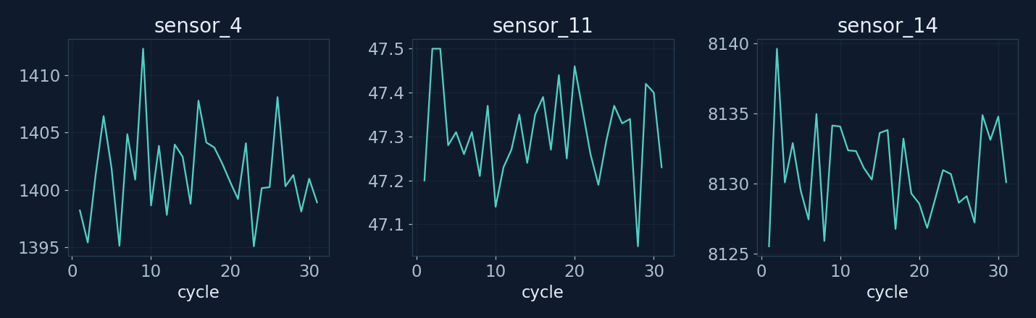
Sensor Behavior Across Cycles
Sensors drift gradually as the engine degrades.
They do not all rise or fall in the same direction.
AeroMind · 9 / 25

Slide 10
Building the RUL Target
Training
Test
No cap
RUL = last cycle of the engine − current cycle.
This formula is not used; NASA provides the true RUL for the last row only.
RUL is used as is, without clipping at 125, so the target stays transparent.
AeroMind · 10 / 25

Slide 11
Feature Engineering: 137 Inputs
17
17
102
1
raw inputs
change from previous cycle
rolling mean and std (5/10/20)
cycle number
Rolling windows use the present and past only, so nothing leaks from the future.
AeroMind · 11 / 25

Slide 12
Leak-Free Data Split
By engine
NASA test set
Cross-validation
GroupShuffleSplit: 80% train, 20% validation, and no engine appears in both.
Untouched until the final evaluation.
GroupKFold with five folds during tuning.
AeroMind · 12 / 25

Slide 13
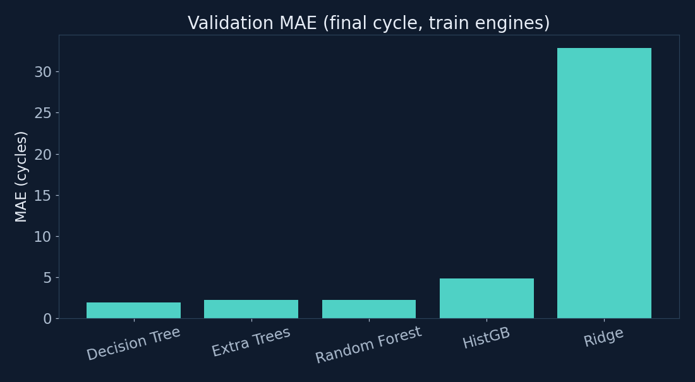
Model Comparison
Five models: Ridge, Decision Tree, Random Forest, Extra Trees, HistGradientBoosting.
Tree-based models clearly beat linear Ridge.
Differences among the trees are small, so Random Forest was chosen for tuning.
AeroMind · 13 / 25

Slide 14
An Important Note on Validation Scores
What happened
Result
True benchmark
Validation used the last cycle of training engines, where RUL is always 0.
MAE ≈ 2.2 and R² = 0 come from an easy check and do not reflect real performance.
The official NASA test set is the reference used in this presentation.
AeroMind · 14 / 25

Slide 15
Tuning the Random Forest
18
12
0.5
5
combinations tried
max_depth
max_features
min_samples_leaf
GridSearchCV with GroupKFold; the best row-level CV RMSE was 40.6.
AeroMind · 15 / 25

Slide 16
The Final Model
Random Forest Regressor inside a Pipeline
Median imputer, then the random forest
Takes 137 features in the order saved in the metadata
Saved with joblib (≈ 28 MB) and used by the app
AeroMind · 16 / 25

Slide 17
Official NASA Test Results
18.1
25.95
0.61
MAE (cycles)
RMSE (cycles)
R²
An average error of about 18 cycles on 100 engines the model has never seen.
AeroMind · 17 / 25

Slide 18
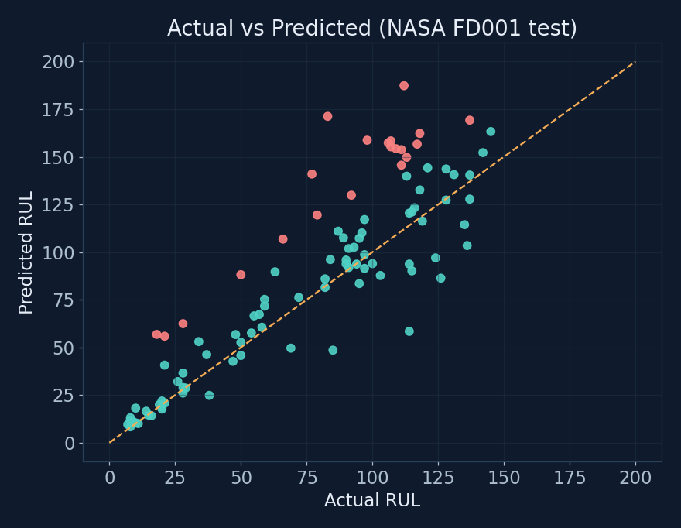
Predicted vs. Actual
Points near the dashed line are accurate predictions.
Red points: predicted more than 30 cycles above the truth.
The largest errors were engines with true RUL of 77 to 112 and predictions above 140.
AeroMind · 18 / 25

Slide 19
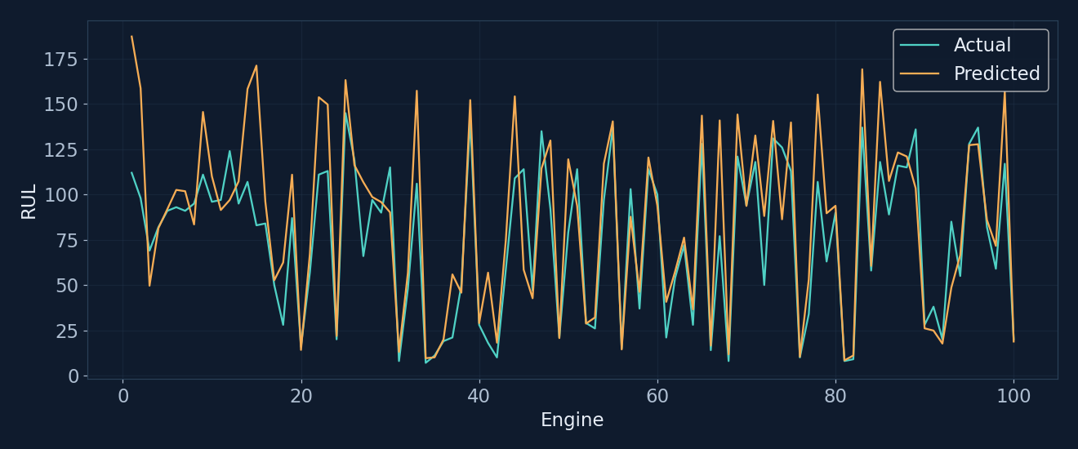
Results for Each Engine
The two lines track each other for most engines.
Some engines show big jumps, notably engine 15 (true 83, predicted 171).
AeroMind · 19 / 25

Slide 20
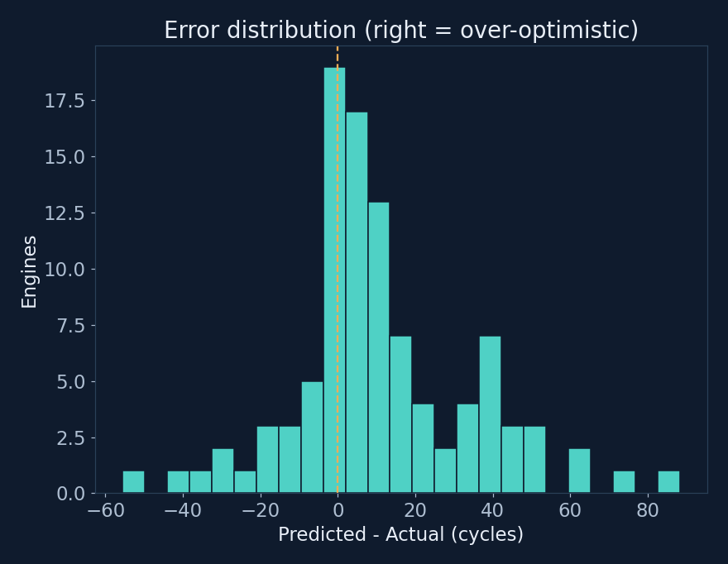
Error Distribution
71% of errors are over-optimistic predictions.
21 engines were overpredicted by more than 30 cycles.
Optimism is riskier than pessimism in maintenance.
AeroMind · 20 / 25

Slide 21
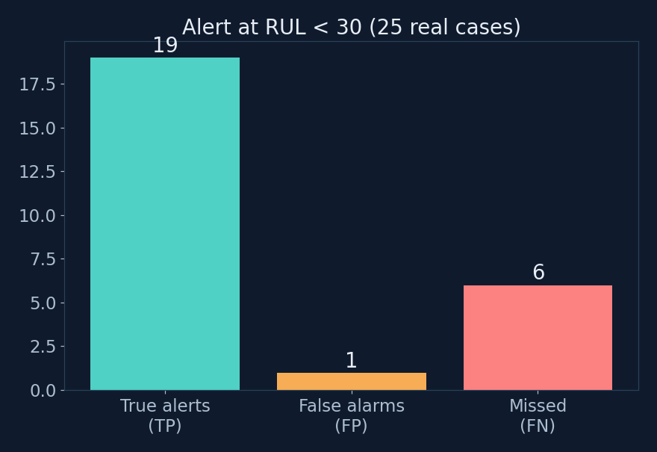
Maintenance Alert (RUL below 30)
25 engines were truly under 30 cycles.
Precision = 0.95 (only one false alarm).
Recall = 0.76: six engines were missed.
AeroMind · 21 / 25

Slide 22
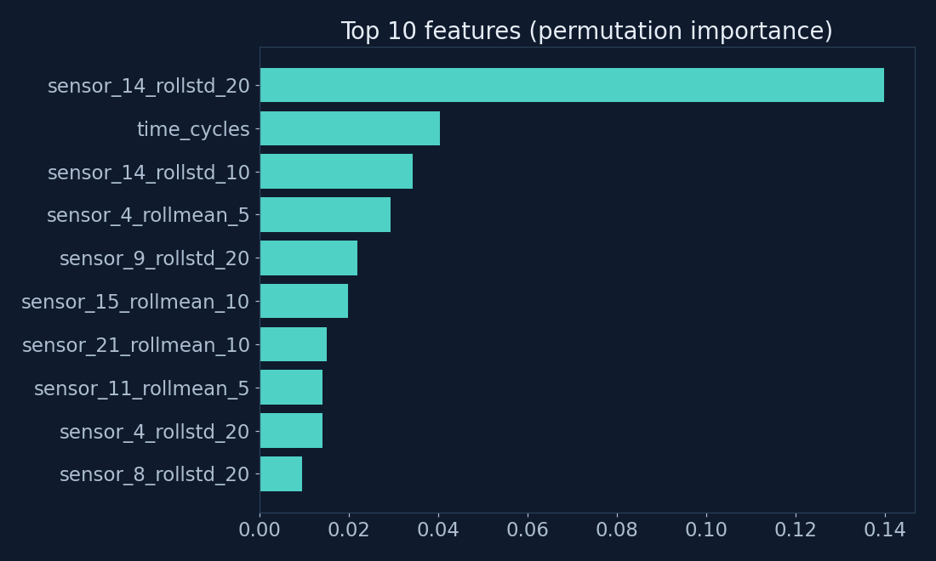
Most Important Features
Top feature: the 20-cycle rolling std of sensor_14, by a wide margin.
Next: cycle number, then rolling stats of other sensors.
This is a diagnostic, not proof of causation.
AeroMind · 22 / 25

Slide 23
AeroMind App (Streamlit)
Live prediction
Status
Model performance
Manual entry or a CSV of an engine’s history; the app builds the same features.
CRITICAL below 30, WARNING below 60, otherwise HEALTHY.
A page with the NASA test results and a feature guide.
AeroMind · 23 / 25

Slide 24
Limitations and Future Work
Limitations
Improvements
Expansion
Simulated data from a single subset (FD001); the model is sometimes optimistic; not certified for real maintenance.
Try an RUL cap at 125, LSTM or other sequence models, and an asymmetric loss to reduce optimism.
Try FD002, FD003, and FD004 with multiple operating conditions and fault modes.
AeroMind · 24 / 25

Slide 25
Conclusion
Random Forest reaches MAE ≈ 18 cycles on the NASA test set
Maintenance alert with 95% precision and 76% recall
A ready-to-try app, with clear limitations
Thank you
AeroMind · 25 / 25

